Slide 1
ADVANCED REACT
Routing in React

Slide 2
OBJECTIVES
In this module, you will
Be introduced to client side routing in React
Understand Dynamic Routing and new features released in react-router 16.4
Create and configure routes for different views
Implement route parameters and nested routes
Create protected routes

Slide 3
React-Router

Slide 4
In an effort to reduce the overheads on traffic to and from servers, and to reduce loading times for webpages, React builds what is known as Single Page Applications (SPAs).
All of the routing is done ‘client side’, resulting in fewer requests to the same server for different pages and much faster navigation on a webpage
We will investigate how to efficiently create a nav system where the main links are permanent, but the sublinks change based on where you are in the structure
SPAs

Slide 5
There were some significant changes in the way routing was managed in react in the version change from v5 to v6.
If you are re-writing or creating a new project, you should be using v6
The current major standard release is 6.4
Among many other updates, features such as nested routes and layouts, Loaders, Error Elements and pending states were perfected in this release
Versions

Slide 6
React need to have the routing installed as an option to allow the features to work. A simple npm install is all that is required.
This will install all other dependencies as well as the interaction with the dom
Installing React Router
Notes:
Installing react-router-dom will install the router too

Slide 7
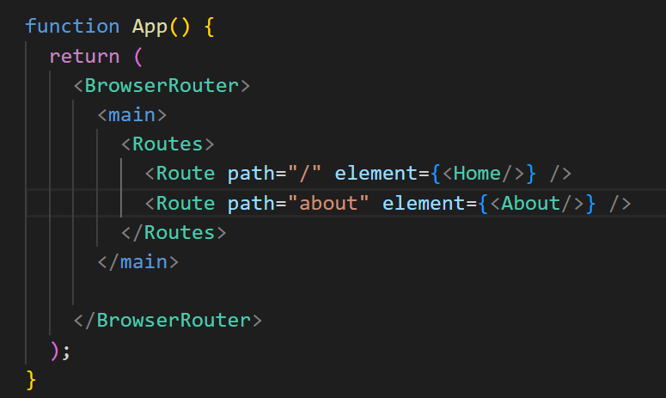
Existing Methods of routing
95% of react code out there follows this method. We will start our app with this method and then see how to update it with the newer ways of working.
In App.jsx, we need to do a few imports
We wrap our App return in a BrowserRouter tag
Notes:
The Routes tag contains all the possible places you can navigate to in the app. “/” represents the default or home page. Notice we don’t have a / infront of the about. This is because react recognises that it’s a base route and puts one on for us dynamically

Slide 8
Creating the pages
Now that we have the routes, we can create the pages they ‘route’ to.
In our setup, the “about route” is linked to the “About” component. The named component is what is rendered when the URL localhost/about is requested
Remember, once the SPA has loaded, this is all performed browser side

Slide 9
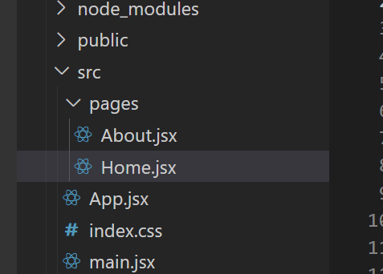
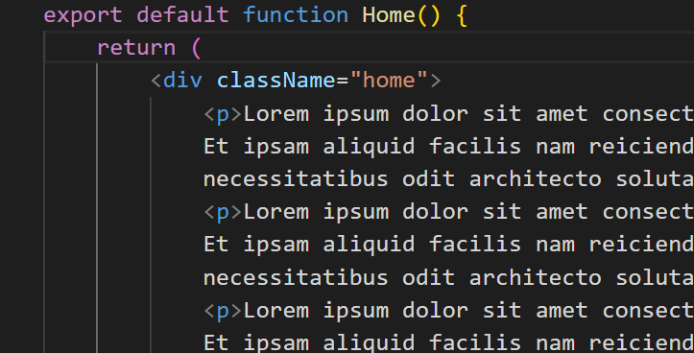
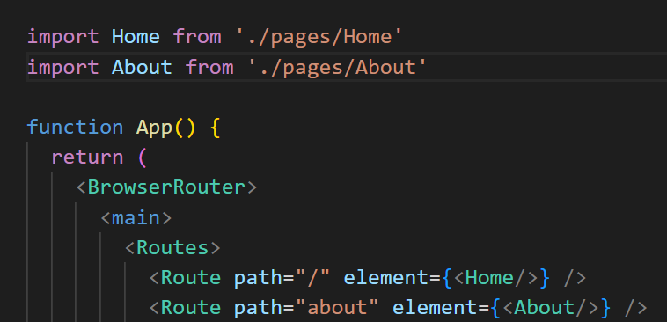
Creating the pages
For this exercise, the pages will be stored in a folder designed to hold them.
Once the pages have been created, they need to be imported into App.jsx

Slide 10
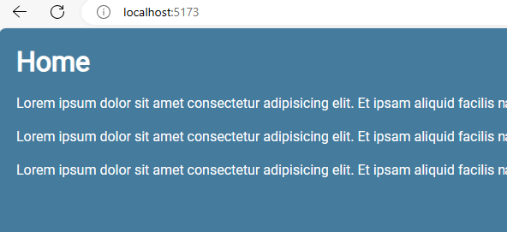
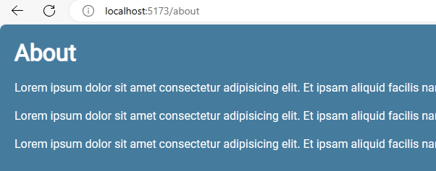
Creating the pages
Although styling is not important for this course, we can apply some to make it easier to see what we are creating. All styles will be provided for you
This will result in something like this
Notes:
@import url('https://fonts.googleapis.com/css2?family=Roboto&display=swap');
:root{
--primary: #457b9d;
--secondary: #a8dadc;
}
body{
font-family: 'Roboto', sans-serif;
margin: 0;
padding:20px;
background-color: var(--primary);
color:white;
}
* {
color: #fff;
margin: 0;
}
p {
margin: 20px 0;
}
button {
border: 0;
padding: 8px;
border-radius: 4px;
color: white;
background: #e63946;
cursor: pointer;
}
header nav {
display: flex;
gap: 16px;
justify-content: end;
max-width: 1200px;
margin: 0 auto;
}
header nav h1 {
margin-right: auto;
border-bottom: 3px solid #e63946;
}
header nav a{
text-decoration: none;
padding: 6px;
border-radius: 4px;
}
header nav a.active {
background: #e63946;
}
main {
max-width: 1200px;
margin: 40px auto;
}

Slide 11
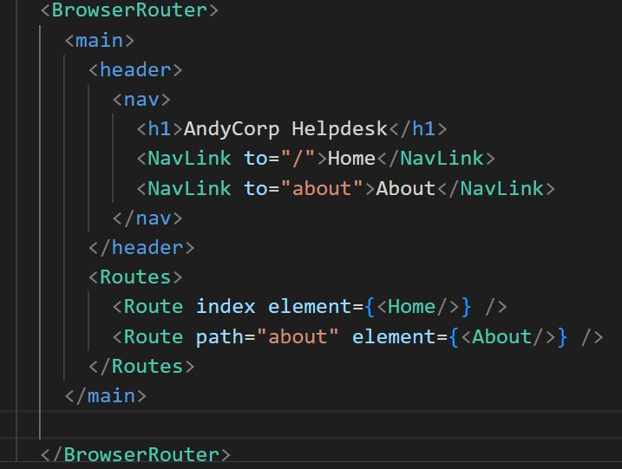
Link and NavLink
React-router-dom uses Link and NavLink to intercept requests to the server and replaces them with the supplied components
NavLink works identically to Link, but includes present styling options to make navigation easier for the user
Notice that ‘index’ has replaced the “/” path
Notes:
Have a look at the virtual dom in browser and watch the js update the dome when you click on NavLink

Slide 12
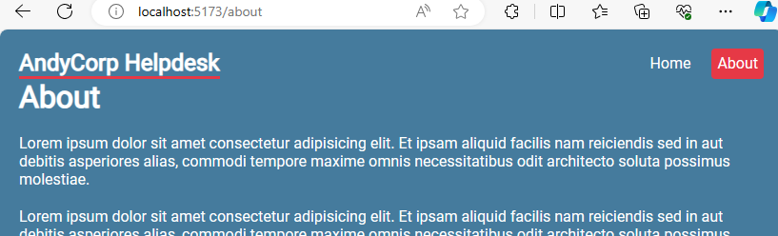
Link and NavLink
When they provided styles are applied, it looks like this.
All routing is already being done on the browser side
Notes:
Have a look at the virtual dom in browser and watch the js update the dome when you click on NavLink

Slide 13
RouterProvider
There was significant change in guidance from React on how to route in 6.4. Introduced here was a RouteProvider which removed the requirement to use BrowserRouter.
In 6.4, we create a browser router to hold the routes and these are passed into provider.
The easiest and arguable most efficient on medium projects is to use createRoutesFromElements, which allows us to route to specified elements in our app

Slide 14
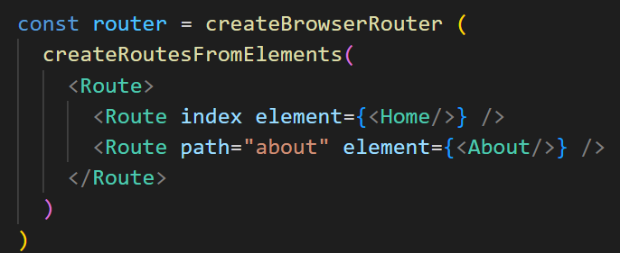
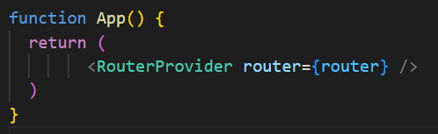
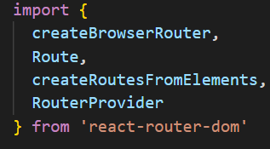
RouterProvider
BrowserRouter is removed completely and replaced with createBrowserRouter and RouterProvider
Notes:
The routes are created externally and then passed into the return. Note that the navbar has been commented out (it will be put into a layout component shortly)
The imports also need to change. We can take out Link and NavLink as they would no longer function. They are used outside of the scope of the createBrowserRouter const.
Notice also that the Routes has been replaced by a single Route tag. We can now create the default layout that allows us to link the root route element to it

Slide 15
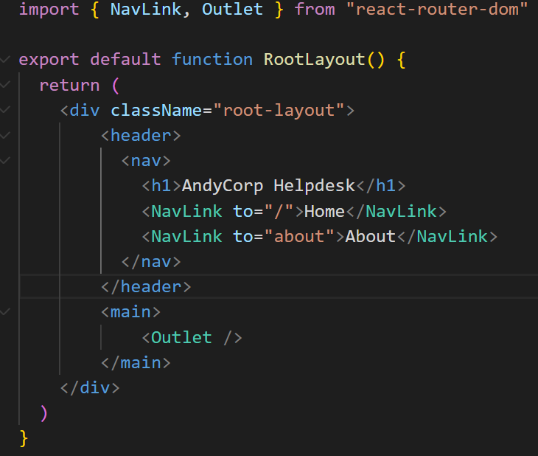
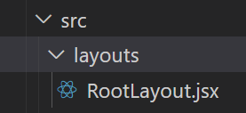
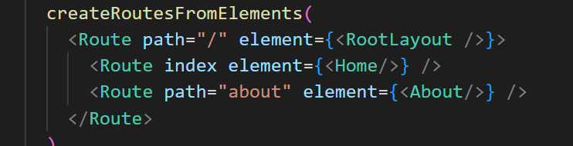
Layouts
We can wrap our entire SPA in our header element created earlier. This can be put into a new component and passed to the root route
Notes:
NavLink works now as it is inside a new component.
Notice the addition of Outlet in the import and the <main> tag. This tells the root layout where to show any children that are rendered.
In our example, <Outlet /> will be either Home or About (We will add more to these moving forward)

Slide 16
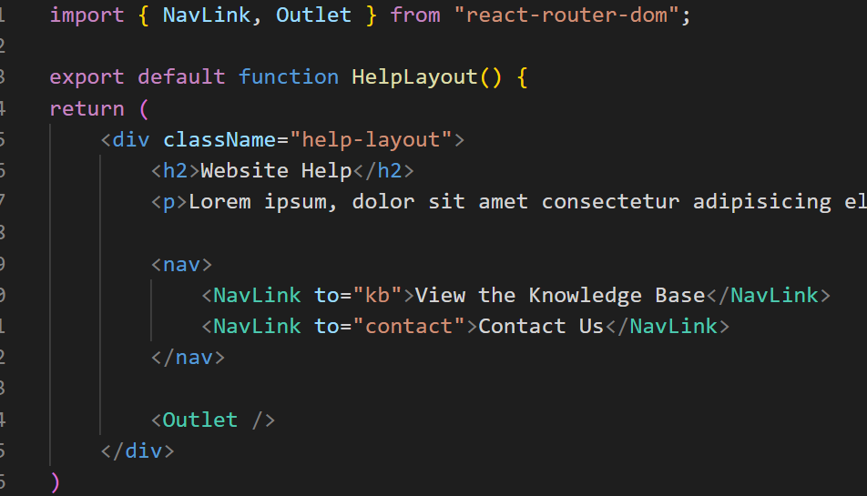
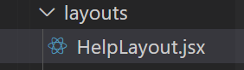
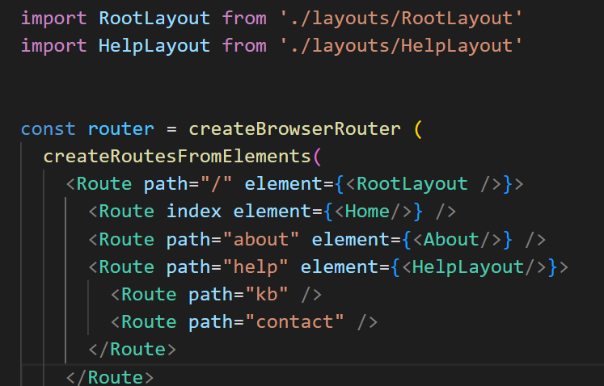
Help Layout
Firstly, we want to create a layout specifically for the help section
Notes:
If we go to localhost/help, it will now show the links “View the Knowledge base” and “Contact us” as they were listed in the Navlinks for the view.
The Home and About links are still visible at the top of the page and the new child content is nested, having been rendered in the HelpLayout inside the RootLayout
The path would become localhost/help/kb

Slide 17
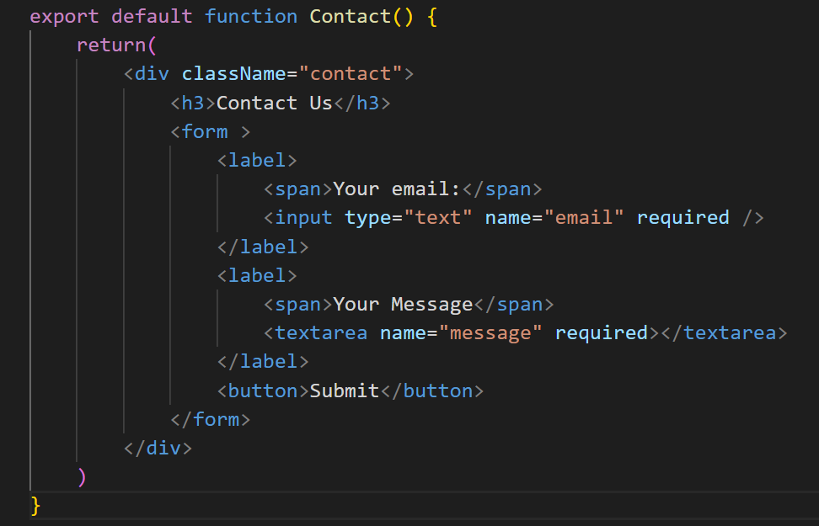
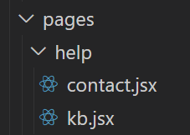
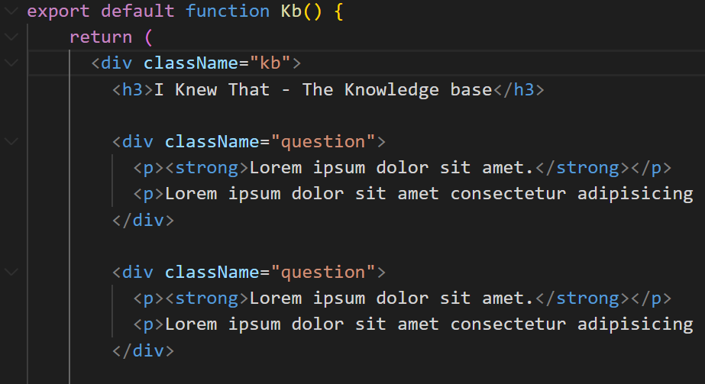
Help Layout
Create the new nested components. It is good practice to separate concerns at this point by dropping the new components in a new folder
Notes:
main {
max-width: 1200px;
margin: 40px auto;
}
.help-layout nav {
display: flex;
justify-content: center;
gap: 30px;
margin: 30px 0;
}
.help-layout nav a{
padding: 10px;
border: 2px solid white;
border-radius: 4px;
text-decoration: none;
}
.help-layout nav a:hover{
border-color: #e63946;
}
.help-layout nav a.active {
background: #e63946;
}
/* KB */
.kb .question {
background: rgba(0,0,0,0.2);
padding: 5px 20px;
border-radius: 4px;
margin: 20px 0;
}
/* contact form */
form {
margin-top: 30px;
}
form input, form label span, form textarea {
display: block;
}
form input, form textarea {
margin-bottom: 30px;
padding: 8px;
border-radius: 4px;
border: 0;
width: 300px;
color: var(--secondary);
}
form label span {
margin-bottom: 10px;
}

Slide 18
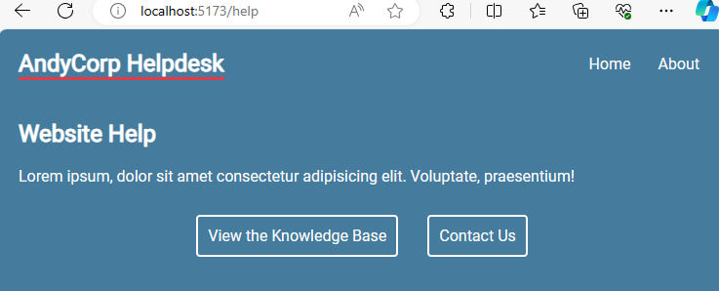
Help Layout
After Some styling, It should look like this
Notes:
main {
max-width: 1200px;
margin: 40px auto;
}
.help-layout nav {
display: flex;
justify-content: center;
gap: 30px;
margin: 30px 0;
}
.help-layout nav a{
padding: 10px;
border: 2px solid white;
border-radius: 4px;
text-decoration: none;
}
.help-layout nav a:hover{
border-color: #e63946;
}
.help-layout nav a.active {
background: #e63946;
}
/* KB */
.kb .question {
background: rgba(0,0,0,0.2);
padding: 5px 20px;
border-radius: 4px;
margin: 20px 0;
}
/* contact form */
form {
margin-top: 30px;
}
form input, form label span, form textarea {
display: block;
}
form input, form textarea {
margin-bottom: 30px;
padding: 8px;
border-radius: 4px;
border: 0;
width: 300px;
color: var(--secondary);
}
form label span {
margin-bottom: 10px;
}

Slide 19
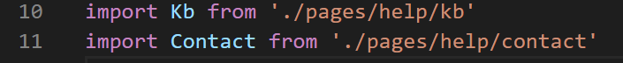
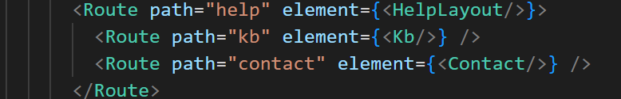
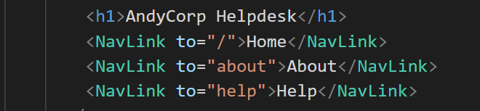
Help Layout
Finally, we need to link the elements to the routes and add the link to help to the root layout
App.jsx
RootLayout.jsx

Slide 20
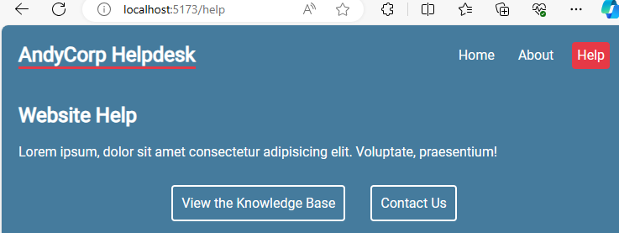
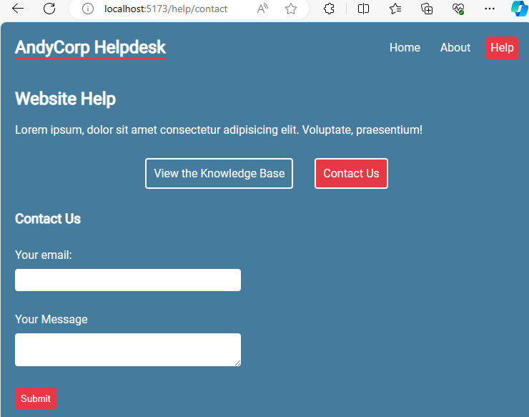
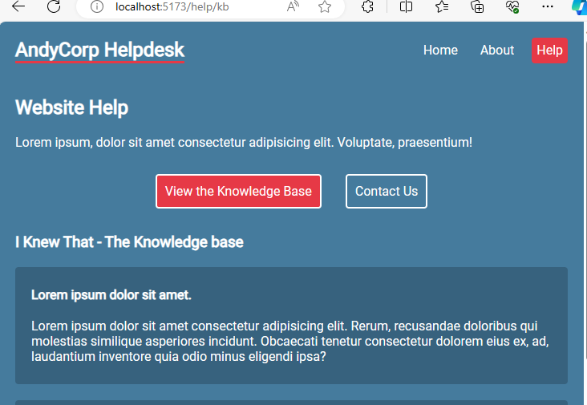
Help Layout
Notes:
Help Button has been added at the top, kb and Contact are available when help is selected, but are not displayed as children until they are clicked

Slide 21
Custom 404 page

Slide 22
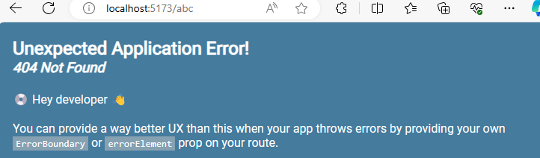
When we navigate to a page that doesn’t exist, we currently get this page
We need to provide our own method of catching routes that don’t exist on our site
Current Behaviour

Slide 23
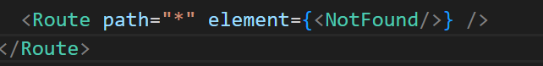
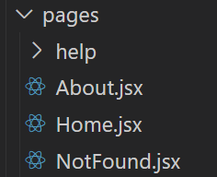
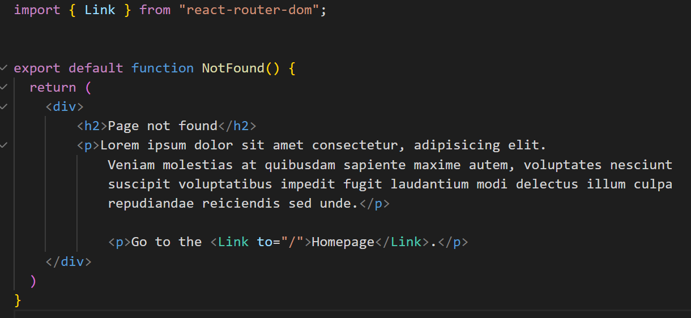
Inside App.jsx, add another Route that can act as a catchall for any other URLs
Create a new component and link the new route to this. (remember to import it at the top of App.jsx)
404

Slide 24
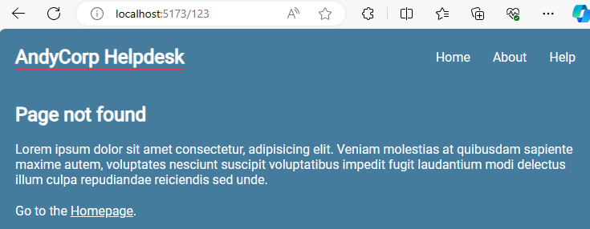
Resulting in a controlled error and a path back to the homepage
404

Slide 25
Loaders

Slide 26
A new feature of 6.4, Loaders pull data into a component before it renders.
This is similar to useEffect(), a hook we will be looking at later in the course. The main difference between them is that Loaders should be used to sync to local data.
useEffect() should be used to sync to external data (i.e. that from completely outside your system)
Basics of Loaders

Slide 27
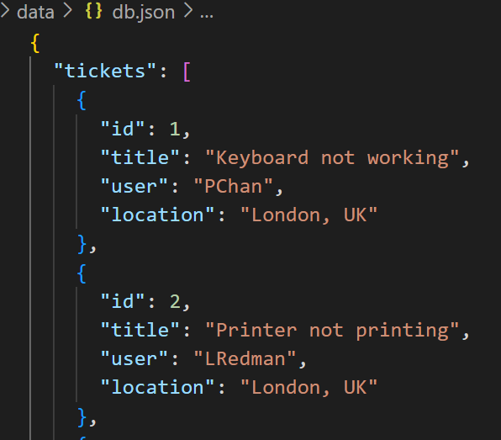
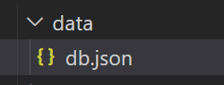
We will need to create a new section of our SPA which deals with the helpdesk tickets that come into our system.
We will be using JSON server to serve up some data
Helpdesk Tickets prep
Notes:
{
"tickets": [
{
"id": 1,
"title": "Keyboard not working",
"user": "PChan",
"location": "London, UK"
},
{
"id": 2,
"title": "Printer not printing",
"user": "LRedman",
"location": "London, UK"
},
{
"id": 3,
"title": "Stool broken",
"user": "PChan",
"location": "London, UK"
},
{
"id": 4,
"title": "Cant login",
"user": "SGerrard",
"location": "Liverpool, UK"
},
{
"id": 5,
"title": "Drives missing",
"user": "MRodgers",
"location": "Manchester, UK"
},
{
"id": 6,
"title": "Lost work",
"user": "KSmith",
"location": "Berlin, Germany"
},
{
"id": 7,
"title": "Missing keys on keyboard",
"user": "EAPoe",
"location": "London, UK"
}
]
}

Slide 28
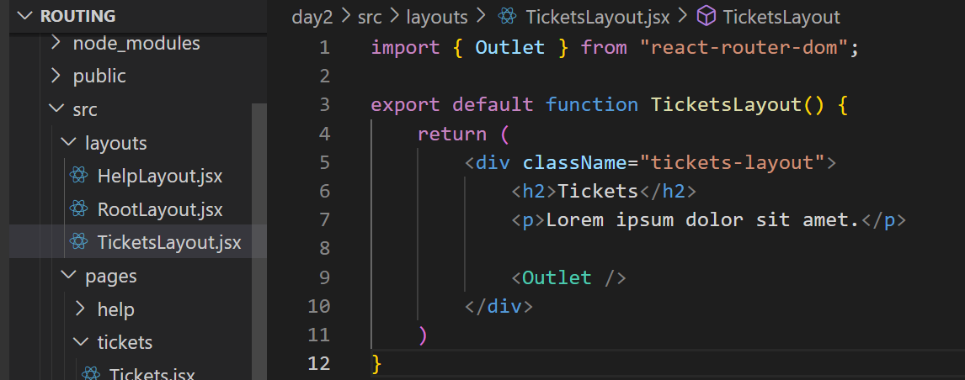
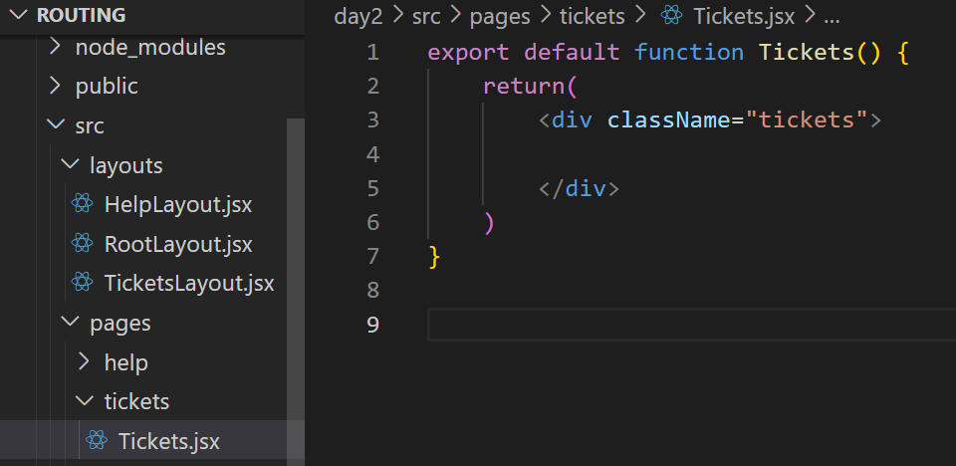
Create a new layout to hold the tickets
Create a new folder in pages to hold the tickets info, and a new component called
Tickets.jsx
Helpdesk Tickets prep

Slide 29
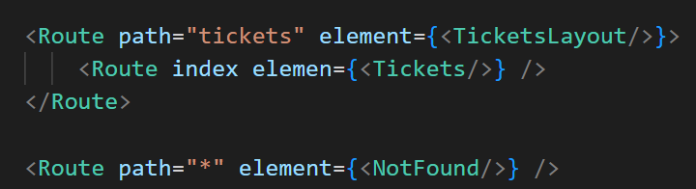
Helpdesk Tickets prep
Create the new Routes in App.jsx

Slide 30
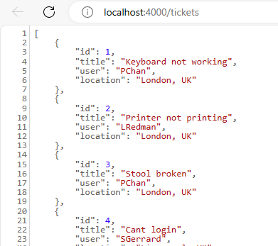
In a new terminal, start the json server and check you can access it in a browser
Helpdesk Tickets prep

Slide 31
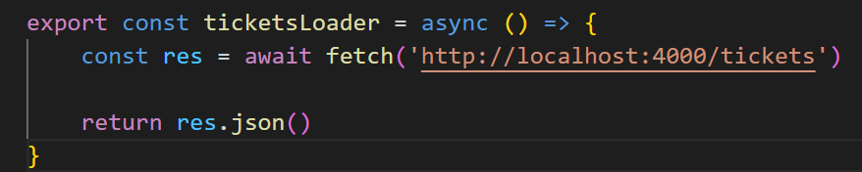
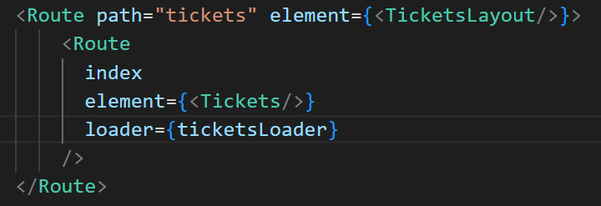
Inside the Tickets.jsx component, underneath the export, you need to create a Loader function to pull the data into the component
In App.jsx, we need to import the loader into the tickets route
Loader function

Slide 32
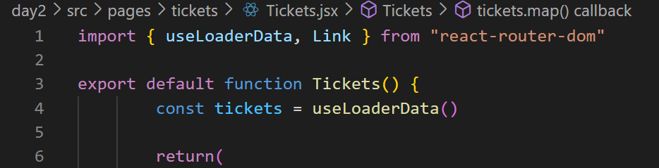
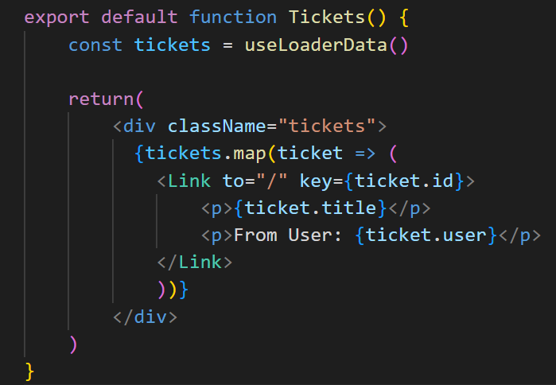
Inside the Tickets function, we need to create a new const which collects the data from the loader.
Link is imported so we can look at individual tickets in the future
This data can then be mapped, just as it would in any other data grab
useLoaderData()
Notes:
The link has been set to the home page for now. This will be updated when the TicketDetails.jsx component has been created

Slide 33
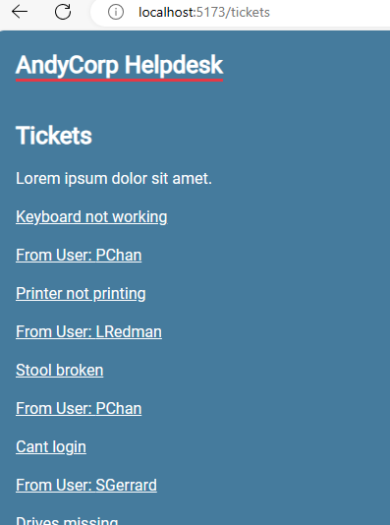
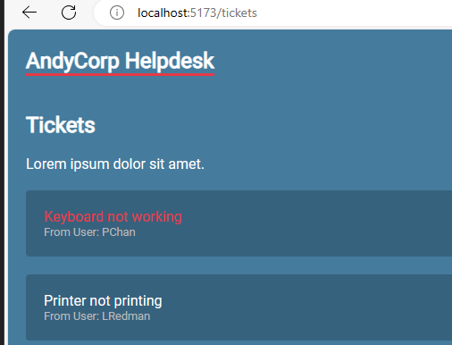
This should now drop the links into the /tickets path
Update the styles
useLoaderData()
Notes:
The links will take up back to the home page when they are clicked for now.
Add a bit of styling
.tickets > a {
display: block;
background: rgba(0,0,0,0.2);
padding: 20px;
border-radius: 4px;
margin: 20px 0;
text-decoration: none;
}
.tickets > a:hover p {
color: #e63946;
}
.tickets p {
margin: 0;
}
.tickets > a p:last-child {
font-size: 0.8em;
color: #bbb;
}

Slide 34
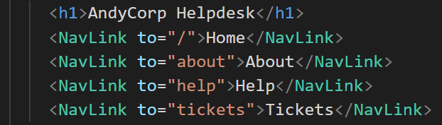
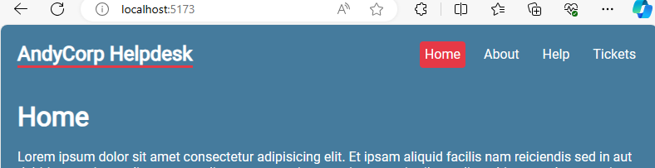
This will update our nav bar
Add Tickets link to RootLayout

Slide 35
Route Parameters

Slide 36
A changeable part of a Route, where components change for each variation
e.g.
/tickets/3
/tickets/765
Each variation is a parameter. We want the page to look the same for each variation, but have the content change when we access it based on the data
Parameters

Slide 37
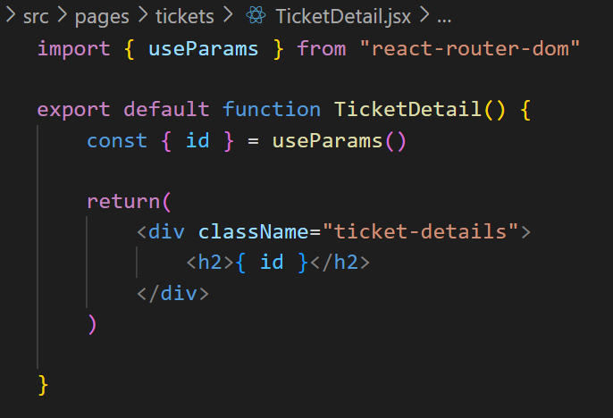
Create a new component in tickets called TicketDetail.jsx
useParams() is a hook that lets us dynamically create content. The { id } is what identifies the individual ticket in the file
Parameters

Slide 38
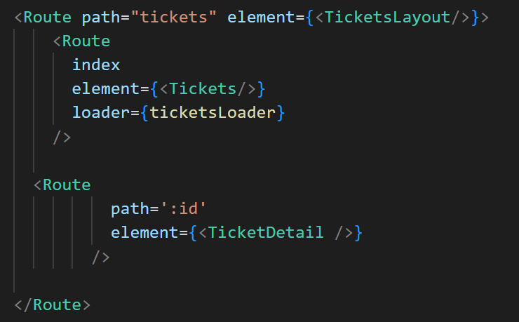
Create a new route in App.jsx, set the path to be “ :id ” and the element to be TicketDetail
Parameters
Notes:
It must be nested inside the tickets element

Slide 39
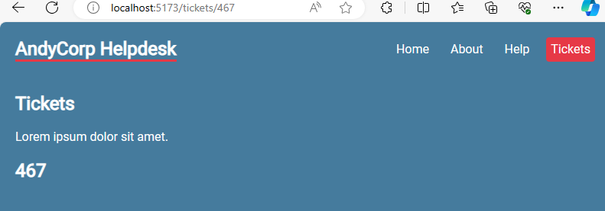
This shows the parameter is being passed to the page
Parameters
Notes:
It must be nested inside the tickets element

Slide 40
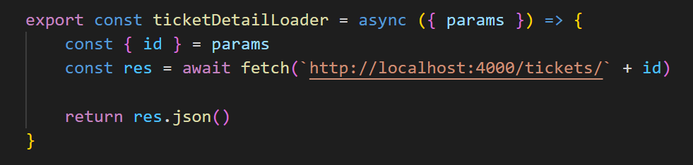
We can now use a loader function to collect the details of the individual Tickets in the system. Inside TicketDetail.jsx create a loader.
Parameters and Loaders
Notes:
It must be nested inside the tickets element

Slide 41

Then pass it into the return
Parameters and Loaders
Notes:
It must be nested inside the tickets element

Slide 42

Link the loader to the route (ensure it is imported)
Parameters and Loaders
Notes:
It must be nested inside the tickets element

Slide 43

Update the link in the Tickets to link to the ticket id detail page. Notice the toString() method
Parameters and Loaders
Notes:
It must be nested inside the tickets element

Slide 44


It will now link the tickets to the ticket page
*Update the CSS
Parameters and Loaders
Notes:
Update the CSS
.ticket-details {
background: rgba(0,0,0,0.2);
padding: 20px;
border-radius: 4px;
margin: 20px 0;
}

Slide 45
Error Elements

Slide 46

Currently, If we navigate to a Ticket that doesn’t exist, we get this page
We need to perform a check in the loader to ensure we alert the user to the fact this doesn’t exist
Current Behaviour

Slide 47

We need to drop some validation into the TicketDetail loader to check if the response is ok.
Solution – Error Elements
Notes:
It must be nested inside the tickets element

Slide 48

Create a new Component called TicketError.jsx in the tickets folder
Solution – Error Elements
Notes:
It must be nested inside the tickets element

Slide 49

Add the new component to the route. Ensuring it has been imported at the top
Solution – Error Elements
Notes:
It must be nested inside the tickets element

Slide 50

We should also be checking that the API is functioning correctly. We can drop the same check in the Tickets Loader
Best Practice
Notes:
It must be nested inside the tickets element

Slide 51

This would work
Best Practice
Notes:
It must be nested inside the tickets element

Slide 52

But to reduce duplication of code, we can delete it from the child routes and put it as an attribute in the parent
Best Practice
Notes:
This is an extension of ‘bubbling’ in vanilla JS

Slide 53
Protected Routes

Slide 54
Provided Code
A repo of starter code has been supplied for you. This will be explained and then we will work through the process of implementing authentication and routes
Notes:
AndySmithQA/Protected-skeleton (github.com) – This is the bare bones
AndySmithQA/Protected-Complete (github.com) – This is the completed working app

Slide 55



About, Account, Home and Private components are simple exports
The Login page contains fields which will be used for authentication
Provided Code

Slide 56

Navigation contains an array with the attributes for the pages we will navigate to.
Notice we have an isMenu element and isPrivate. These determine if the element is rendered
Provided Code

Slide 57


RenderNavigation exports 2 constants.
RenderRoutes, which checks to see if the route will be private
RenderMenu which build the Menu itself based on privacy settings
Provided Code

Slide 58

App.jsx uses BrowserRouter and drops the Header into the page, then any Menu Items that are available, then maps the routes to the page
We will wrap all of this in Authentication, which will then change the menu items available to the user
Provided Code

Slide 59

There have also been some CSS styles applied to the webpage
Provided Code
Notes:
.header {
background-color: lightblue;
padding: 20px;
}
.header h1 {
margin-bottom: 0;
text-align: center;
color: white;
}
.logo {
float: left;
padding: auto;
}
img{
width: 60px;
}
.menu {
background-color: lightblue;
margin-top: 20px;
text-align: center;
display: flex;
justify-content: center;
gap: 20px;
}
.menu .menuItem {
display: inline-block;
margin: 0 30px;
}
a{
color: white;
text-decoration: none;
}
.page {
padding: 30px;
text-align: center;
}
.page h2 {
text-align: center;
}
.page p {
text-align: center;
}
.inputs {
text-align: center;
height: 30px;
}
.inputs .input input {
height: 30px;
width: 300px;
margin: 5px 0;
}
button {
text-align: center;
background-color: lightblue;
border: none;
padding: 15px 30px;
color: #fff;
width: 308px;
margin: 10px 0;
}

Slide 60


Notice there is no Login link rendered as yet.
This is because isMenu is set to false
You can access the page by typing the extension into the address bar
Provided Code

Slide 61

Firstly, we need to create authentication to wrap all routing inside. This component will let the user log in and will then update an isAuthenticated variable to change what the user can see.
Create a new component in the auth folder called AuthWrapper.jsx
Import { createContext, useContext, useState } from react
Import RenderHeader, RenderMenu and RenderRoutes
Wrapper
Notes:
We will discuss these later in the week. Context allows us to manage where state is shared within our components

Slide 62

Create a const called AuthContext which will equal createContext()
export a const called AuthData which equals useContext(AuthContext)
Wrapper

Slide 63

export const AuthWrapper as usual. Here we will create some state and allow that user to login and logout
This will not be real authentication however, we will mock a link to API
Wrapper
Notes:
Note that any username is accepted for this mock, but the password must be password

Slide 64

Create a logout function
Wrapper
Notes:
The … spread simply takes the user logged in and changes their authentication to false

Slide 65

We need to replace all the routing currenting in App.jsx and put it into this wrapper.
Once done, we can drop the AuthWrapper into App.jsx itself
Wrapper
Notes:
The … spread simply takes the user logged in and changes their authentication to false

Slide 66

App.jsx
Now, all routes and access is controlled by the authentication process
Wrapper

Slide 67


Back in RenderNavigation import AuthData.
Create a new const which pulls the user status into the component
Inside RenderRoutes, we need to update the logic to allow routes to check if the user has signed in
Updating Render Navigation

Slide 68

Inside RenderMenu, we need to update the logic to display the login / logout menu item
Updating Render Navigation

Slide 69


We can now render either login or logout on the navbar based on whether a user is logged in or not
Note a tiny adjustment to the CSS file (remove the 30px left and right margin)
Updated menu items
Notes:
There will have to be a slight adjustment to the CSS file

Slide 70


We need to do quite a bit of work with the login page. We will use a hook called useReducer and we can create an error message to alert for an incorrect password
First, we create the ability to redirect users with useNavigate
Login Page

Slide 71



Then we call in the login function from AuthData()
Then we consolidate all the input data using useReducer()
Then set an error message
Login Page

Slide 72

Create an async function called doLogin which will employ a try and catch to validate the login
This checks the username and password and redirects to the Account page if successful
Login Page

Slide 73


Update the input boxes to trigger the useReducer()
Add the action to the button
Login Page

Slide 74


Finally, drop a check for an error and conditionally render the message
Update your CSS too
Login Page

Slide 75

In account, import AuthData and add the user context
Account Page

Slide 76


When you log in with Bill and password
You have access to the new routes
Final Page

Slide 77

And can see the private members area
Final Page

Slide 78
Labs and Activities

Slide 79
Break in to pairs and create a website for a shop which sells plants.
Your website should:
Have nested routes
Have a protected ‘your details’ page
Have products that can be displayed in a products page
Spend some time planning your layout. You should create a repo and either clone and branch, or mob code the product
Pair Coding

